Slide 1

PTSD: A Data Driven Approach Team HIMAT
06 March 2018
COPYRIGHT © CENTER FOR HEALTH SYSTEMS INNOVATION
ALL RIGHTS RESERVED

Slide 2
Introduction
General Background
PTSD is alternatively known as ‘Shell Shock’ or ‘Combat Stress’
It occurs after an individual experiences severe trauma or a life-threatening event
70% of adults in the U.S. have experienced some type of traumatic event at least once in their lives
The figure rises to approximately 223.4 million people
Common treatments for PTSD:
Medication
Different types of Psychological Interventions
Gap
Gap is how PTSD progresses over time (Krystala, 2009)
Problem Statement
How can we improve the quality of treatment for Post Traumatic Stress Disorder by using the patient data like:
Demographic factors
Encounter Details
Record of Anti-depressants, etc.

Slide 3
Methods
Data Cleaning
Both datasets are combined (General & PTSD)
PTSD_FLAG variable is created
1 – PTSD Dataset
0 – General Dataset
BMI column is created using height and weight variables.
Outlier rows were removed having impossible heart rate such as:
Less than 40
Greater than 250.
NULL values in binary columns were changed to 0.
New dataset created with ID, PTSD_AGE and ‘number of encounters’ for symptoms like
Anxiety
Depression
Suicide
Drug abuse
PTSD
Finally a flag is added for each symptom type to represent whether a patient never experienced any of a symptom type
Notes:
Datasets combined to reduce the chance of base rate fallacy

Slide 4
Methods
Data Analysis
In SAS EM,
Models – trees, neural nets & regression
Target variable - PTSD_FLAG
Method - Imputation and Variable selection
Predictors – Demographic, Clinical & Lab Values
In Tableau,
Demographic variables were plotted as a ‘percentage of the total’ using PTSD_FLAG to see patterns in PTSD patients
In Tableau,
PTSD_AGE was graphed overtime in comparison to each type of symptom encounters in order to see the trend of PTSD symptoms overtime
In SAS EM,
Target - Symptoms encounters from 2011-2015
Predictors - Antidepressant Flags & Psychology Procedures
Method - Regression
Since the data is oversampled, a decision node in SAS EM is used to adjust for the estimated of PTSD in the population (3.6%)

Slide 5
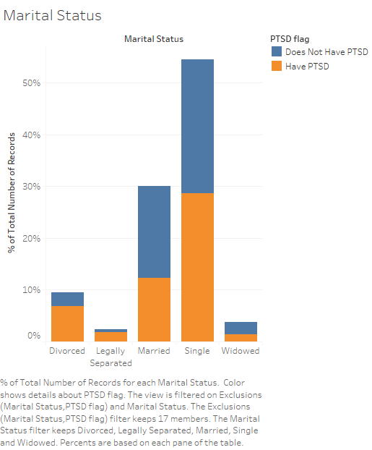
Marital Status with PTSD in Tableau

Slide 6
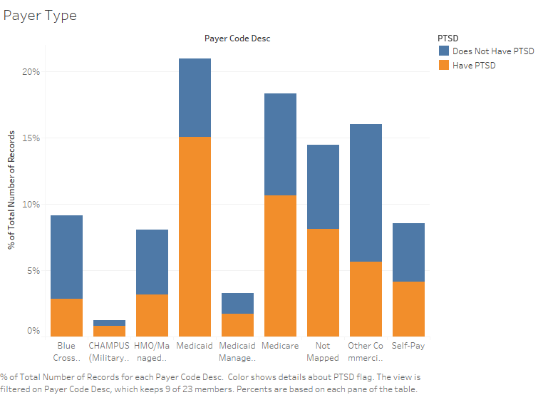
Payer Type with PTSD in Tableau

Slide 7
Encounters over the years in Tableau

Slide 8
Discussion
Only demographic variables can be used to predict PTSD
Best model was Decision Tree
Hit-ratio was 52% after running a model as opposed to 50% (best guess)
The model doesn’t do any better than chance
Sensitivity is 4.8%, better than chance
Problem - Too many missing values
Imputation improves the neural net, but leads to bias
By looking at the individual factors in Tableau, we can state:
Demographic factors related to stress are associated with PTSD
Notes:
Note: Just because a hospital event happened after the first encounter of PTSD, does not mean it preceded PTSD, because PTSD would have been present before its diagnosis for example cannot use hospital encounters, because it wouldn’t be clear which variable goes first
Used SAS EM to use many different modeling types to predict PTSD based on demographic factors including: lab values (such as platelets), clinical values (such as weight, BMI), location information (urban/rural and census_division), marital status, age and gender.
The challenge in using models in this case is the large amount of missing data. Regression and neural nets can only be used if there are no null values in the explanation variables. Imputation can be used, but that introduces more bias. Trees don’t have that problem, but still were not very effective.
For the reason above looking at the factors individually yielded more insightful results, although there is the worry of lurking variables. What this means is a third variable could account for both a patient being on medicaid and them having PTSD.
For last point: Monetary stress was related to PTSD (patients with medicaid), as was relationship related stress (legal separation and divorce).

Slide 9
Discussion
By assuming the number of encounters is an operationalization of severity of symptoms, we can see that the following decrease over time:
Anxiety
Suicidal Thoughts
Drug & Alcohol abuse
The doctors can console their patients by saying –
Symptoms will naturally get better overtime even they’re feeling bad currently
They don’t improve over time:
Depression
PTSD related encounters
Limitations:
The time PTSD was diagnosed may long after its onset
Specific patients are not tracked overtime, a max of five years is possible

Slide 10
Discussion
Regression Structure:
Symptom Target Encounters = Intercept + Antidepressant flag(1) + … Antidepressant flag(9) + # Psychological treatments
Statistically significant anti-depressants and the number of psychological treatments lead to:
An increase in the number encounters relating to each symptom
There could be selection bias and no way to conduct temporal analysis
Other drugs may need to be investigated as the efficacy of these drugs is questionable
Existing research has questioned the efficacy of anti-depressants.
Notes:
Each target variable was then filtered for values above 0. Thus isolating the effect of antidepressants on people with specific symptoms
The selection bias being that the antidepressants are given to the patients with the most severe symptoms
Also the analysis isn’t temporal meaning that we aren’t specifically looking at the impact after being given antidepressants. This is the best we can do with this data, but in the future a double blind controlled trial could be conducted.

Slide 11
Recommendations
PTSD should be rebranded to represent those who suffer from it in a better way
Doctors should track patients PTSD symptoms severity overtime
Symptoms decrease naturally over time
Doctors should console the patients by giving a hope of improvement
Consoling could in turn lead to a lessening of symptoms
Focus more on depression that doesn’t improve naturally overtime
Doctors should make use of hospital resources
Symptoms improve more with intervention than just analysing
Treatments other than antidepressants and psychological procedures should be further investigated temporally.
Separating out psychological treatment that a patient receives would be useful as-
Research shows that Eye movement desensitization and reprocessing might be more useful than other methods for treating PTSD
Notes:
This includes removing the stigma that PTSD is associated with the extreme stressors relating to war.
PTSD is related to common life stressors including monetary as demonstrated by its overrepresentation of those on medicaid and relationship as demonstrated by the overrepresentation by those divorced and legally separated.
Someone might believe that PTSD only affects those that undergo extreme stressors like witnessing mass death during wars or experience a horrible life event such as a near death experiences.
This may make them underemphasize their symptoms to not seem mentally weak. The truth is PTSD will effect 7% of people and is could be related to a combination of stressors as opposed to one very strong stressor.

Slide 12
APPENDIX

Slide 13
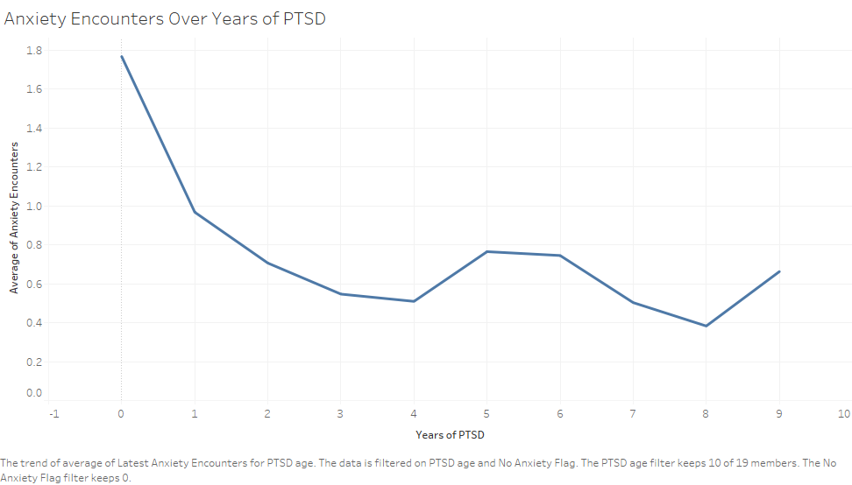
Anxiety Encounters

Slide 14
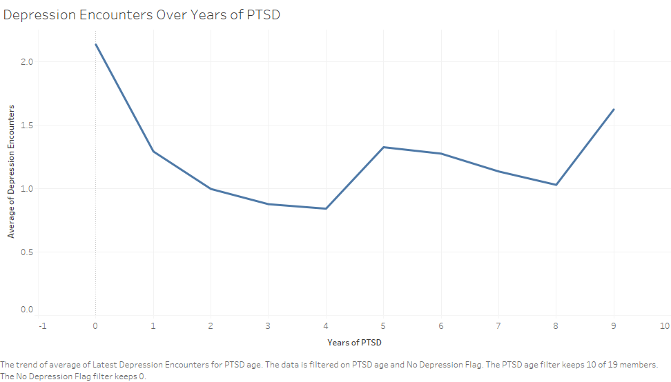
Depression Encounters

Slide 15
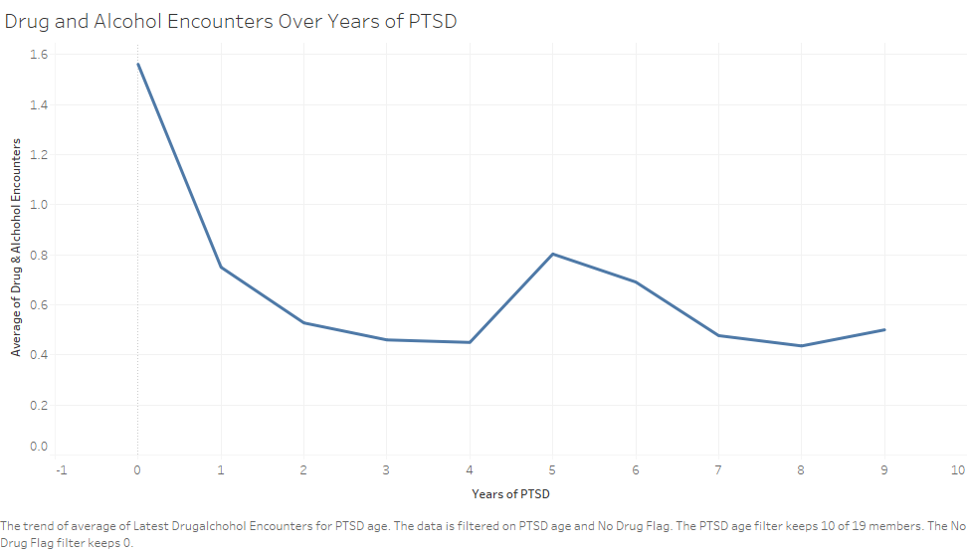
Drug and Alcohol Encounters

Slide 16
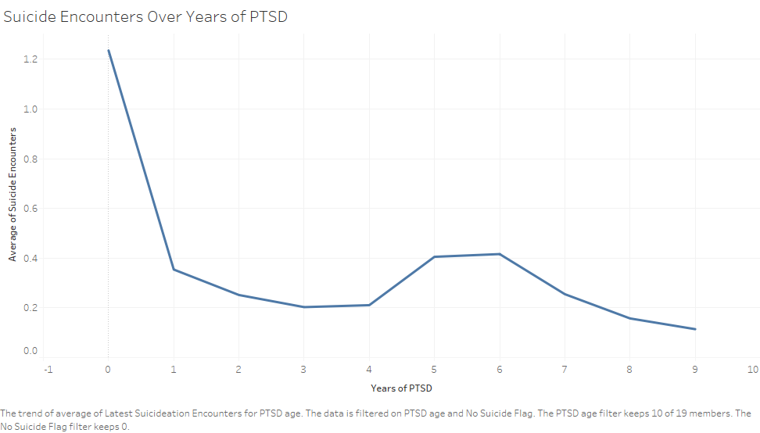
Suicide Encounters

Slide 17
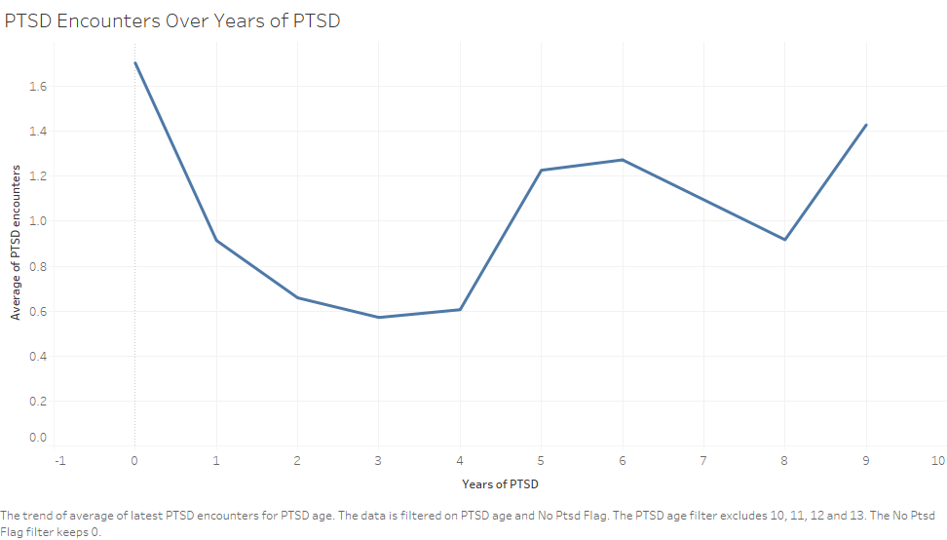
PTSD Encounters

Slide 18
Key Business Questions
Can PTSD be predicted based on demographic factors?
Does PTSD symptoms have a pattern over-time?
Does anti-depressants or therapy reduce the severity of the symptoms?
How is PTSD linked with Charleston?

Slide 19
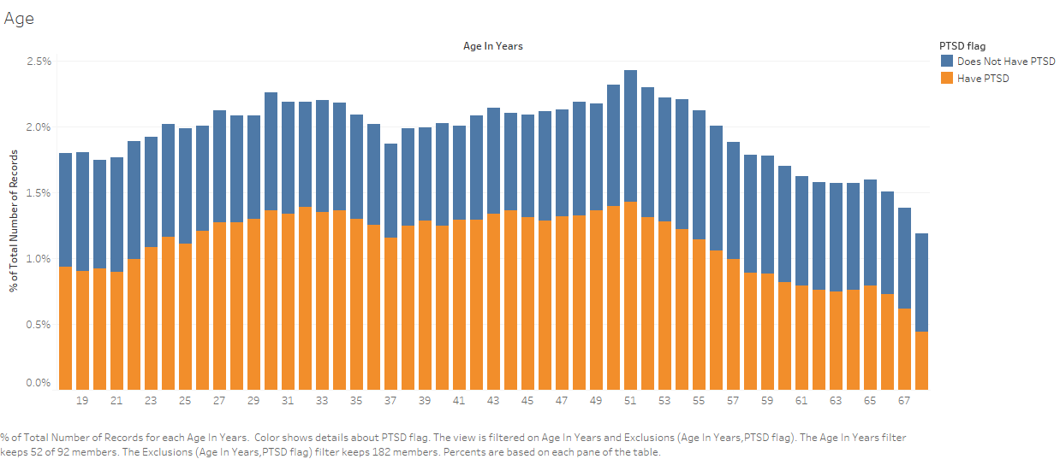
Age with PTSD in Tableau

Slide 20
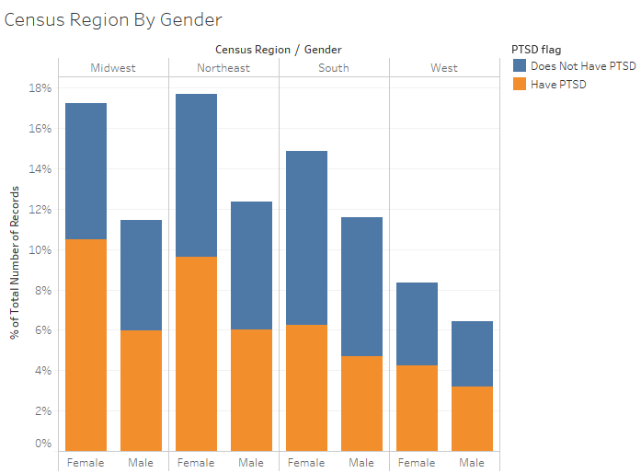
Census Region by Gender with PTSD

